Slide 1
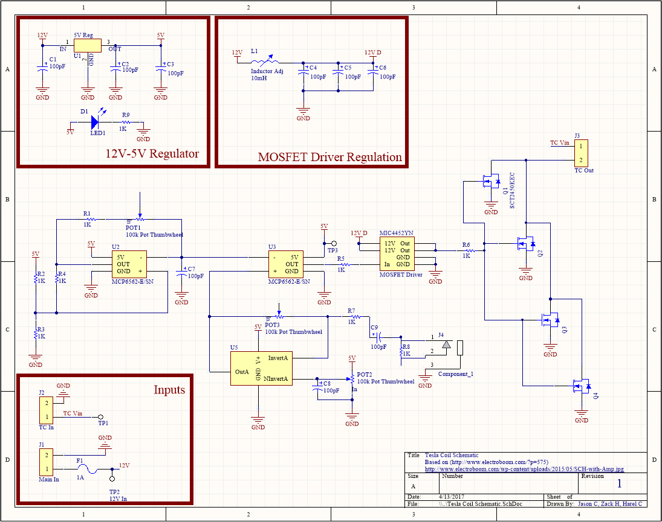
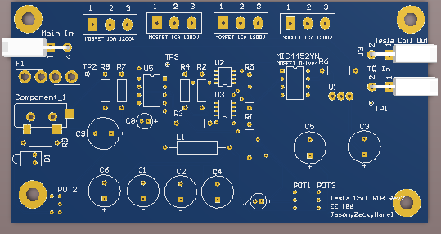
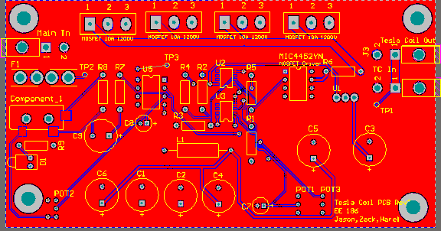
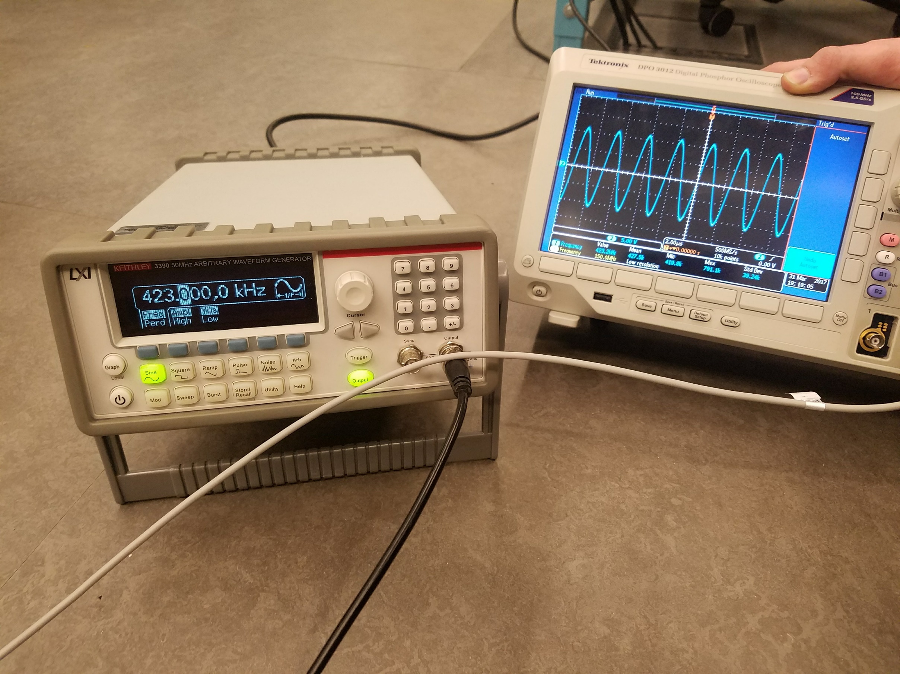
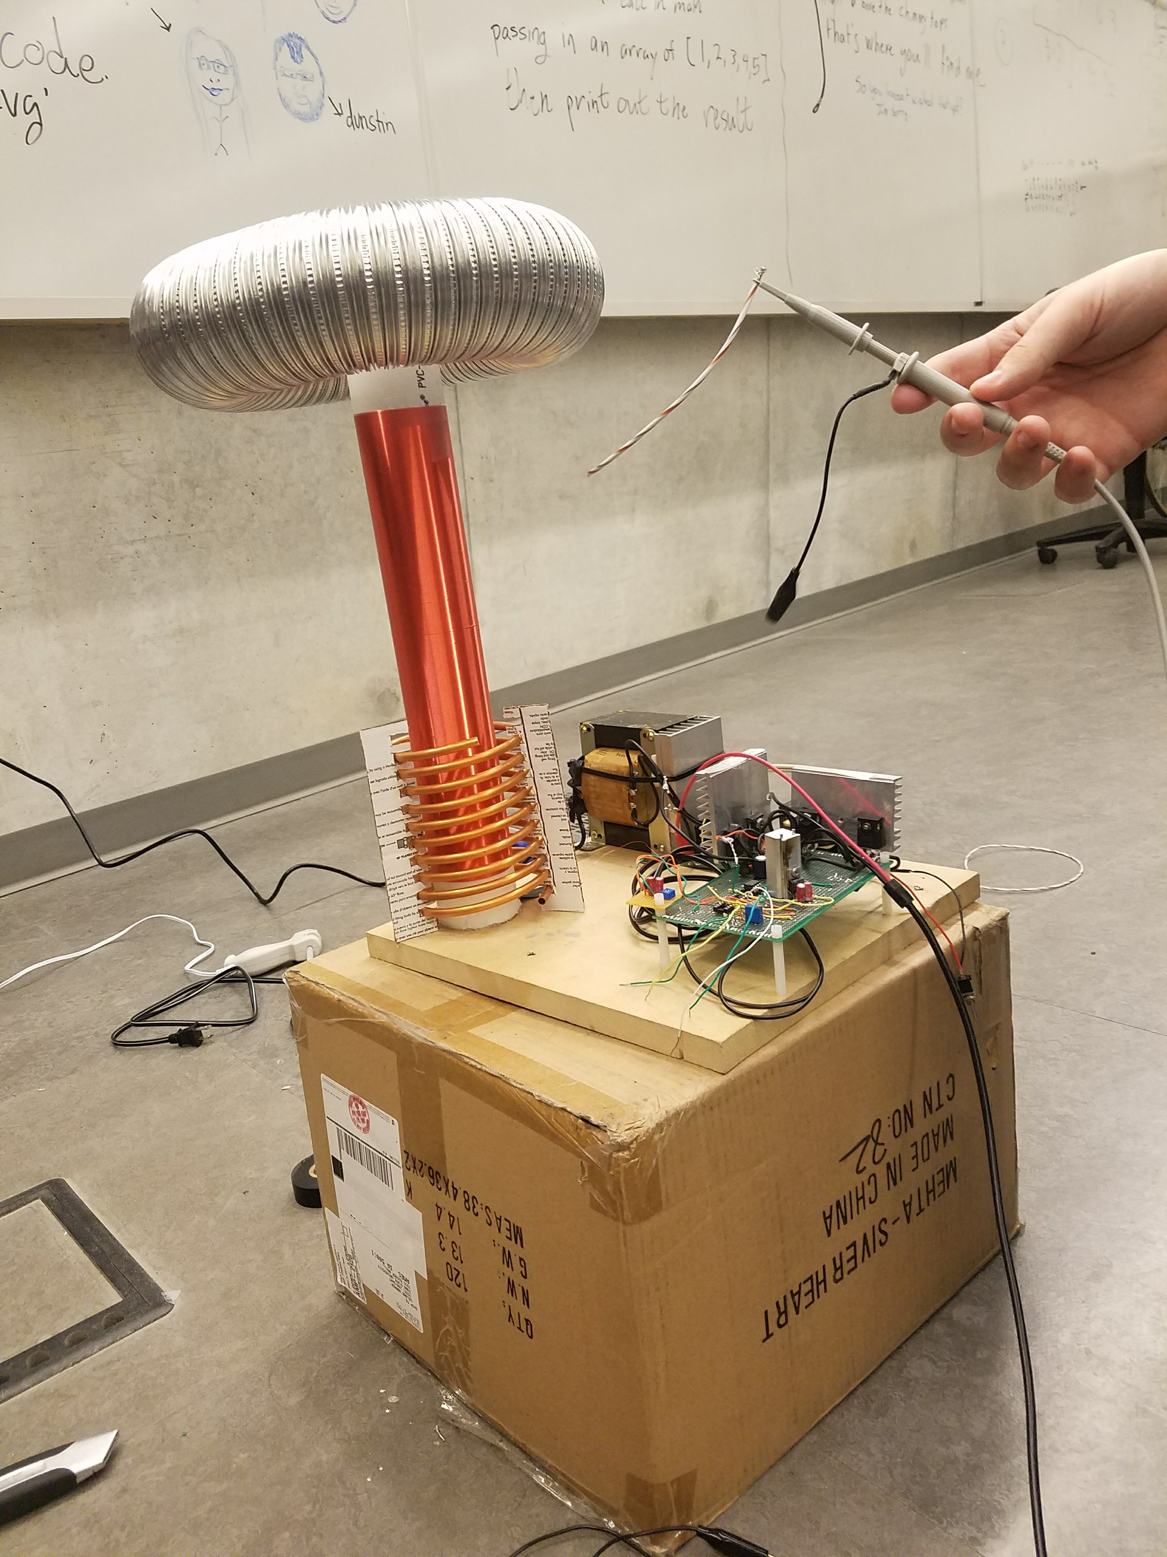
Department of Electrical and Computer Engineering
Freshman Research Initiative Symposium
April 24th, 2017
Jason Cheng, Zack Higgs, Harel Cohen
Observing Wireless Energy Transfer Using Tesla Coil Technology
Abstract
Methods
To research and learn about generating high voltage frequency and converting high frequency electromagnetic fields into useable energy. In doing this, we explore the field of wireless energy transfer, a well known idea recognized around the world, yet not fully explored. By exploring this, we hope to understand how to implement the technology into daily lives of people. With this research idea, we can create a new way to distribute energy to large areas, power electronics, charge batteries, and make this technology as commonplace as plugs and sockets are today.
To explore wireless energy transmission, a tunable Tesla Coil was designed and built. We modified an existing coil found on ElectroBoom and drew a schematic to run it (Figure 1). To accomplish the goals we had for tunable signals, we designed a Printed Circuit Board (PCB) that allows for 2 inputs of 12 volts and outputs 12 volts to run the Tesla Coil and a signal to control it (Figure 3). In doing this, we also explored tools such as multimeters, oscilloscopes, and function generators to extend our knowledge on Tesla Coil. We also found and calculated functions such as, resonant frequency, pulse frequency, and duty cycle.
Figure 1: Custom Schematic drawn for project
Figure 3: Electrical and Model View of the PCB
Results
Conclusions
In testing and refining the coil, we discovered for maximum efficiency of the tesla coil, the circuit driving the coil must resonate at the same frequency of the coil. We saw the circuit must generate a frequency between 400 to 450 Kilohertz (Figure 2). The resonant frequency of the coil itself is dependent on the many factors, the greatest of which is the toroid. Other factors include distance from the ground, humidity, and outside disturbances.
In this project, we were able to explore the concept of wireless energy by powering objects through a generated electromagnetic field. Any object within this field is able to absorb the energy. For example, a fluorescent light bulb within the field will suddenly turn on due to the energy absorbed by the bulb. In future experiments, the energy will be used to turn on small electronics from a distance and possibly charge batteries. In future applications, we plan to further tune the coil to maximize range and find the relationship between efficiency and range of power transfer. By doing this, we can further explore the relationship and use of the tesla coil.
Citation
Figure 2: Frequency and Signal Testing
S, Mehdi . "Music, Magic and Mayhem with Tesla Coil." ElectroBoom. May 26, 2015. Accessed April 09,
2017. http://www.electroboom.com/?p=575.
Figure 5: The Tesla Coil
We would like to thank: The Electronics and Technology Group at Iowa State University and the Howard Hughes Medical Institute

